Slide 1

Data Analysis of Unicorn Companies
Lokukhanya kamanga
(daf-July cohort)

Slide 2
Content
History of Unicorn Companies
Overlook on Investments
Growth Recommendations
Conclusion

Slide 3
History of unicorn companies
Most companies were founded after 1970, took almost a century to experience the exponential growth of many in different countries.
-The founded companies were able to join the Unicorn companies over the years giving a mean of year 2012,by 2016 75% of them had joined the Unicorn Company.
On observation greater funding was on cybersecurity, mobile and tele-communication, fintech amongst the top industry as high as 946M, most of them were given $1B.

Slide 4
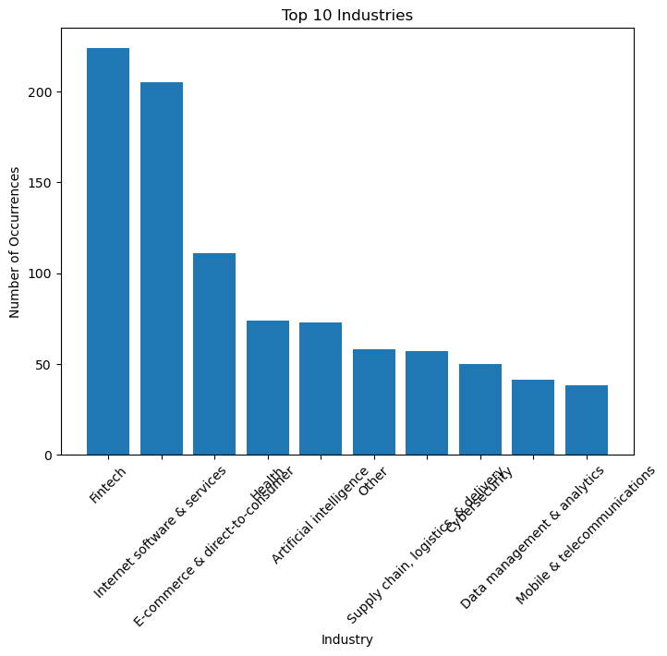
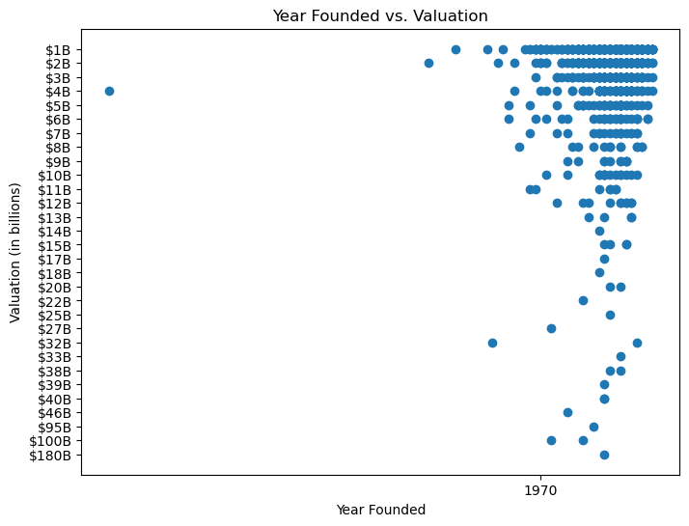
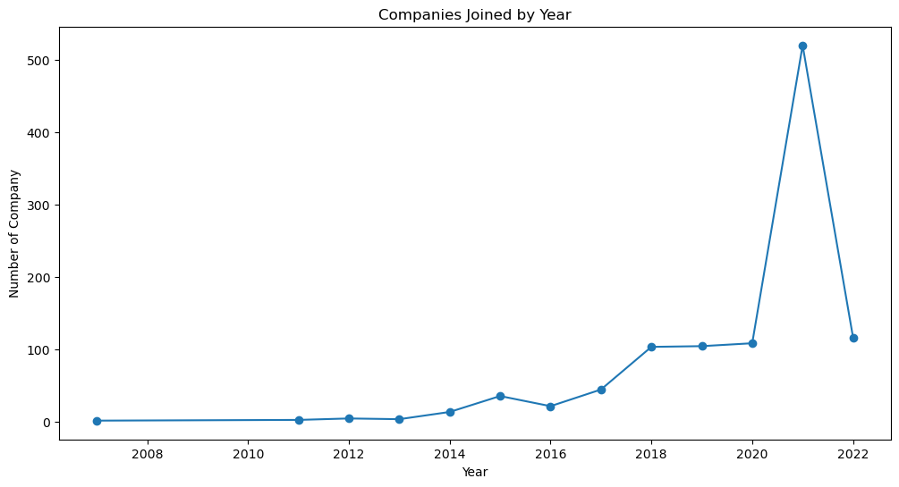

Slide 5
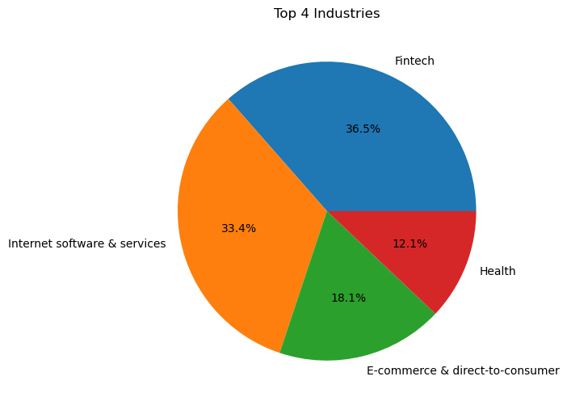
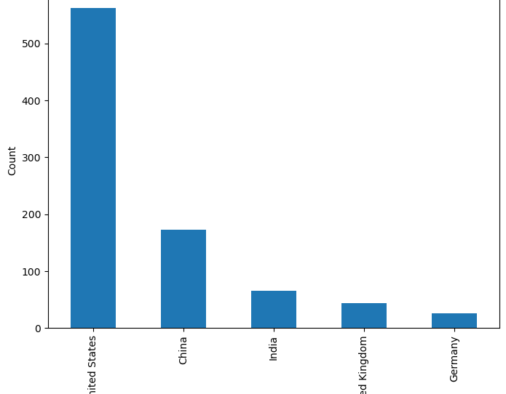
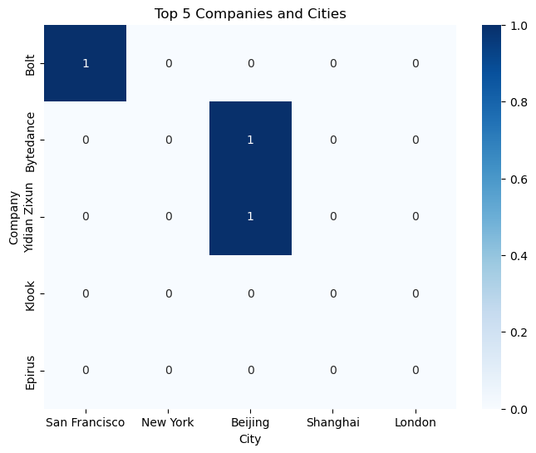
Overlook on Investments
United States has the top companies and leading on the top industries with high Valuation. Having San Francisco and New York being 2 cities on the lead.
China being the second leading, on observation, Beijing hubs the 2 top leading companies ie, Bytedance and Yidian Zixun.

Slide 6
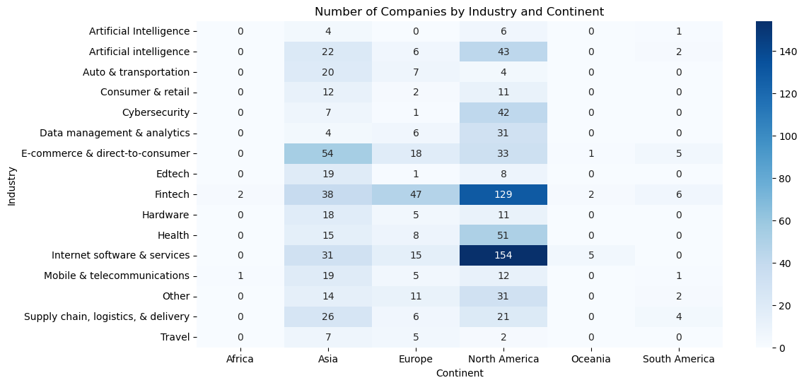
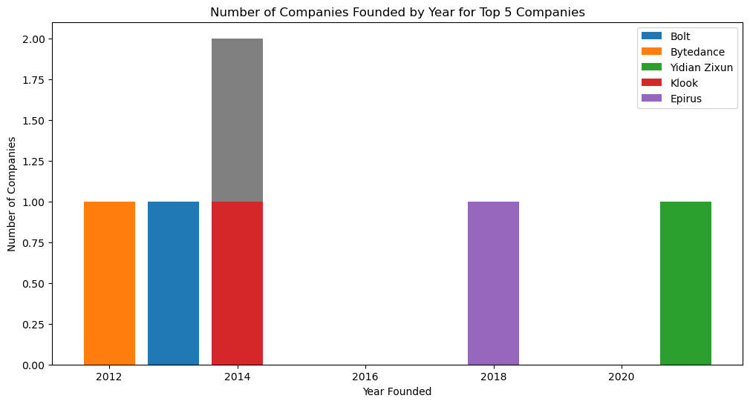
Growth Recommendations and Conclusion
These top 5 companies are spacey concentrated in Africa, South America for growth would recommend they invest more in them due to their population growth.
Investors like Sequoia, Pelion Venture Partners, Foundation Capital Thamo, Bravocapital and could also investigateon expanding CyberSecurity and Mobile and telecommunications in Europe. In Africa they should invest more in Mobile and telecommunications, Health, Supply chain logistics and deliveries since these are industries that are mostly drive their Economy
More funding should be focused to Asia that way the Industries would grow
With the experience of Companies like Bytedance, Bolt Klook their leadership and experience would lead the continents like Asia, Europe and Africa increase their Gross Returns

